Slide 1
Building a Complete Rails App
Models, Migrations, ActiveRecord, Gems and Tests

Slide 2
What’s for today
Models
Migrations
SQL and ActiveRecord
Gems
Tests via RSpec

Slide 3
Prerequisites
A Rails 4.2 app
Connection to MySQL server with an empty database

Slide 4
Rails Models
Data container
Provides connection with database
Uses ActiveRecord as Object Relational Mapping (ORM) framework
Also contains business logic (unless moved to service objects)

Slide 5
Let’s Make a Model
Run in your ssh:
rails generate model User name:string score:integer
Generates a new model named User in app/models/user.rb
Model names are singular
Use CamelCase for multi-word models
Creates a migration to create a table named users with columns id, created_at, updated_at, name and score in the database

Slide 6
What are Rake Tasks and Migrations?
Rake Tasks are just ruby code that are run using your app’s environment
You can create your own rake task by creating *.rake files in lib/tasks/ folder
Migrations are ruby code that alter the database in some way (like creating a new table)
They are used by a rake task included in rails called db:migrate
Generating a new model creates a new migration, but you can also create your own using rails generate migration

Slide 7
More About Migrations
Their filenames include a timestamp so that they are run chronologically
Because you can’t delete a table before creating it
Why are they needed?
So you can go back to a specific state of your app in the past (for example before you deleted a table)
So you can commit code that changes your database

Slide 8
Let’s Run That Migration
Run in ssh: bundle exec rake db:migrate
bundle exec means ‘using the current gems of my app (those in the Gemfile), execute the next command’
rake is the command for running rake tasks
db:migrate is the rake task named migrate in the db namespace (like a package or module)
This will run the migrations and create the users table in the database

Slide 9
ActiveRecord
Maps 1 database row into 1 Model object
Provides methods for querying the database more easily

Slide 10
Let’s Try It Out
Open a rails console by running rails console
It’s a ruby console with your app’s environment
You can affect the database while in console
Check that the User model exists by typing User in the console
Get all users: User.all.to_a
to_a forces the SQL query to run eagerly (immediately) and return an array
take note of the SQL query generated and executed

Slide 11
More ActiveRecord Magic
Create a new user:
User.create(name: ‘John’, score: 0)
Automatically adds a new database row with the column values
Create another one:
u = User.new # not yet in the database
u.name = ‘Peter’
u.save # this is where it gets saved to the database

Slide 12
AR Continuation
Querying with condition:
user = User.where(name: ‘Peter’).to_a
get all users with name ‘Peter’
Updating an existing record
user.score = 10
user.save
Deleting an existing record
user.destroy or
User.where(name: ‘Peter’).destroy_all

Slide 13
Custom SQL in ActiveRecord
Custom where clause:
User.where(‘score < ? AND name = ?’, 10, ‘John’).to_a
Don’t put the values directly to avoid SQL injection
Last resort, sql string:
User.find_by_sql([‘select * from users where name = ?’, ‘John’])
Returns an array, so no need to call to_a

Slide 14
Other ActiveRecord Methods
select
order
limit
joins

Slide 15
Let’s Make Another Model
rails generate model GameEquipment name:string user_id:integer quantity:integer weight:float date_bought:date fragile:boolean
We will add an association between User and GameEquipment, that’s why we added the user_id attribute/column
run the migration: bundle exec rake db:migrate

Slide 16
Add Associations
Edit app/models/game_equipment.rb
Inside the class definition, add:
belongs_to :user
This tells ActiveRecord to use the user_id column as a foreign key to the users table (User model)
Edit app/models/user.rb
Inside the class definition, add:
has_many :game_equipments
This tells ActiveRecord that the game_equipments table has foreign keys to the users table.

Slide 17
How Does That Work?
reload the rails console by exiting using exit and starting a new one, or by typing reload!
create a new game equipment for John:
u = User.where(name: ‘John’).first
GameEquipment.create(user_id: u.id, name: ‘coin’)
get all of John’s game equipment:
ge = u.game_equiments.to_a
get a game equipment’s user:
ge = GameEquipment.last
u = ge.user

Slide 18
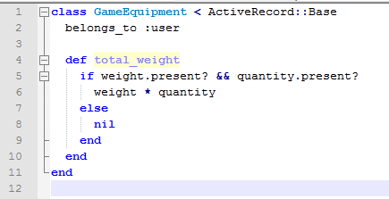
Let’s Add a Model Method
edit app/models/game_equipment.rb
add an instance method called total_weight:

Slide 19
Let’s Try That Method
Reload the rails console using reload!
Get the GameEquipment we created earlier:
ge = GameEquipment.last
IMPORTANT: after running reload!, you have to re-fetch the model(s) to get the updated version.
Call total_weight: g.total_weight
it should return nil
Add weight and quantity:
g.weight = 3.5
g.quantity = 5
g.save # optional
Call total_weight again: g.total_weight
it should return 17.5

Slide 20
Gems
Gems are libraries that you can add to your app
You can add gems to your app by editing the Gemfile file
The gems are hosted on rubygems.org

Slide 21
Gemfile
The Gemfile contains information about the gems that your app will use.
Just add gem ‘<gem_name>’ to add that gem
You can also add gems to specific running environments (i.e. development, test, staging, production)
gem ‘capistrano-rails’, group: :development
You can also specify the gem’s version:
gem ‘rails’, ‘4.2.0’
not specifying the gem version means you’ll use the latest stable version

Slide 22
Let’s add a gem!
add gem ‘hotwater’ to your Gemfile and save it
run bundle install in ssh to download and install the gems
open rails console to try the new gems
to try hotwater, type:
Hotwater.ngram_distance(‘abc’, ‘acb’)

Slide 23
Testing with RSpec
RSpec is a gem for automated testing
Add the rspec gem: gem ‘rspec-rails’
Run bundle install to install RSpec
Initialize RSpec by running:
rails generate rspec:install
Create spec file (test file) for GameEquipment model:
rails generate rspec:model GameEquipment
this will create the file spec/models/game_equipment_spec.rb
after you install RSpec, all new models you generate will have its own spec file.

Slide 24
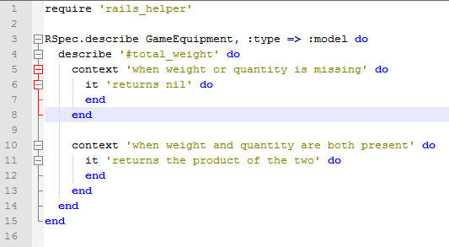
Testing with RSpec
edit the game_equipment_spec.rb file

Slide 25
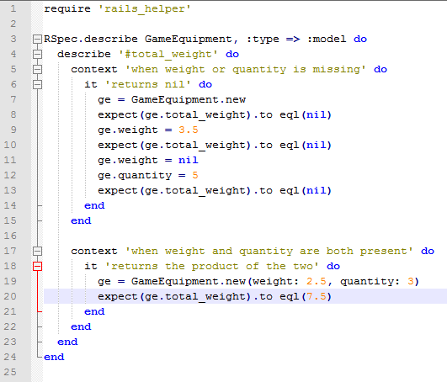
Testing with RSpec
Completed test for total_weight method:

Slide 26
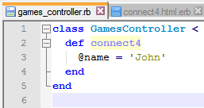

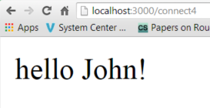
One Last Thing
To Pass data from controller to view, use instance variables:

Slide 27
Exercise
Create a new path /users that displays the names of all the users in the database

